Slide 1

Flutter. Widgets and app lifecycle
Ulugbek Isroilov
GDG Tashkent
t.me/ulugbekisroilov

Slide 2
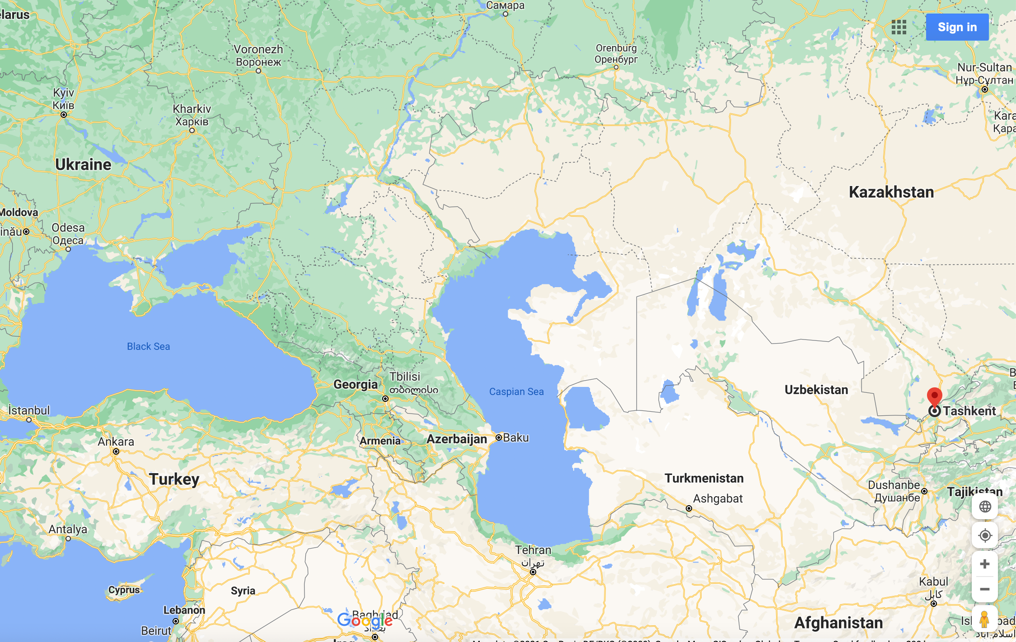
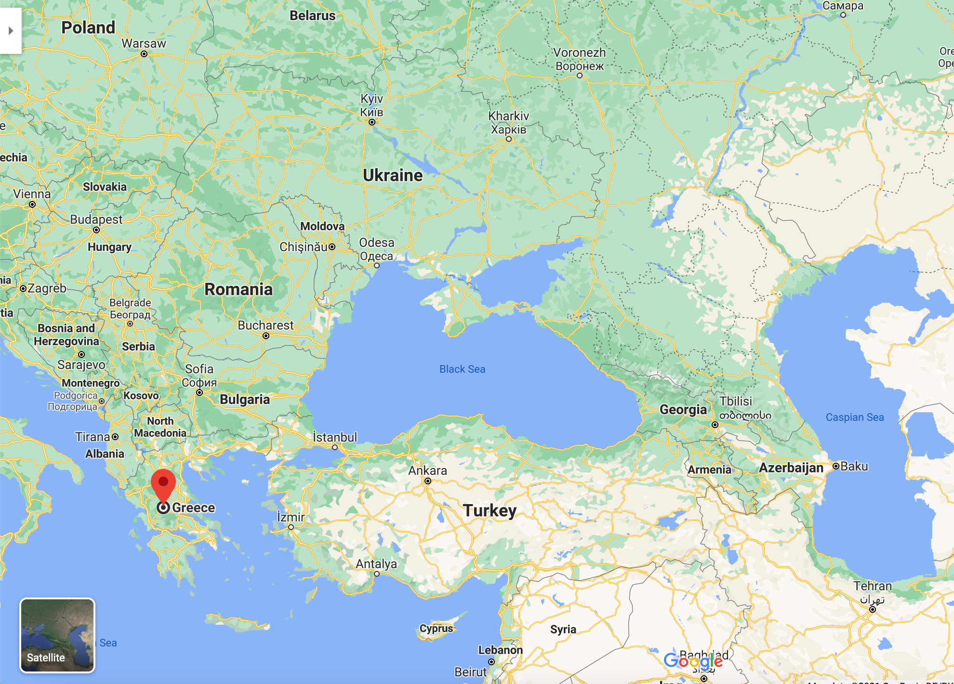

Slide 3
About me
Tashkent, Uzbekistan
ViaBill A/S, Denmark
GDG Tashkent
Flutter Uzbekistan

Slide 4
Agenda
Flutter Widgets
Widget Lifecycle
App Lifecycle

Slide 5
Flutter Widgets
StatelessWidget
StatefulWidget
InheritedWidget
constructor
constructor
updateShouldNotify
build
createState

Slide 6
State Lifecycle
mounted = true
initState
didChangeDependencies
clean
didUpdateWidget
build
setState
dirty
deactivate
dispose

Slide 7
@ovveride
void initState() {
super.initState();
// Initialization of widget
_open = false;
_textController = TextEditingController();
_scrollController = ScrollController();
_scrollController.addListener(_onScrollChange);
_myBloc = MyBloc(repository: widget.repository);
// ..
}

Slide 8
@ovveride
void dispose() {
// ..
_myBloc.close();
_scrollController.removeListener(_onScrollChange);
_scrollController.dispose();
_textController.dispose();
// Widget is removed from widget tree
super.dispose();
}

Slide 9
@ovveride
void didChangeDependencies() {
super.didChangeDependencies();
// Configuration of Dependencies / InheritedWidgets were changed
// Also is called after initState, but before build
// do some expensive work (e.g., network fetches)
// when dependencies change, and that work would be
// too expensive to do for every build
}

Slide 10
@ovveride
void didUpdateWidget(MyWidget oldWidget) {
super.didUpdateWidget(oldWidget);
// Configuration of widget was changed
if (widget.streamController != oldWidget.streamController) {
oldWidget.streamController.removeListener(_streamListener); widget.streamController.addListener(_streamListener);
}
if (widget.size != oldWidget.size) {
_animationController.forward();
}
}

Slide 11
@ovveride
Widget build(BuildContext context) {
// This method can potentially be called in every frame
// and should not have any side effects beyond building a widget.
}

Slide 12
What about App Lifecycle?

Slide 13
class _MyWidgetState extends State<MyWidget> with WidgetsBindingObserver {
@ovveride
void initState() {
super.initState();
WidgetsBinding.instance.addObserver(this);
}
@ovveride
void dispose() {
WidgetsBinding.instance.removeObserver(this);
super.dispose();
}
}

Slide 14
@override
void didChangeAppLifecycleState(AppLifecycleState state) {
switch (state) {
case AppLifecycleState.detached:
// It can either be in the progress of attaching a view when engine was first // initializes, or after the view being destroyed due to a Navigator pop.
case AppLifecycleState.inactive:
// The application is in an inactive state and is not receiving user input.
// Apps in this state should assume that they may be paused at any time.
case AppLifecycleState.paused:
// The application is not currently visible to the user,
// not responding to user input, and running in the background.
case AppLifecycleState.resumed:
// The application is visible and responding to user input.
default:
}
}

Slide 15
Tips
Learn basics
Understand reactive programming paradigm
Learn from mistakes
RTFM
Keep Fluttering!

Slide 16
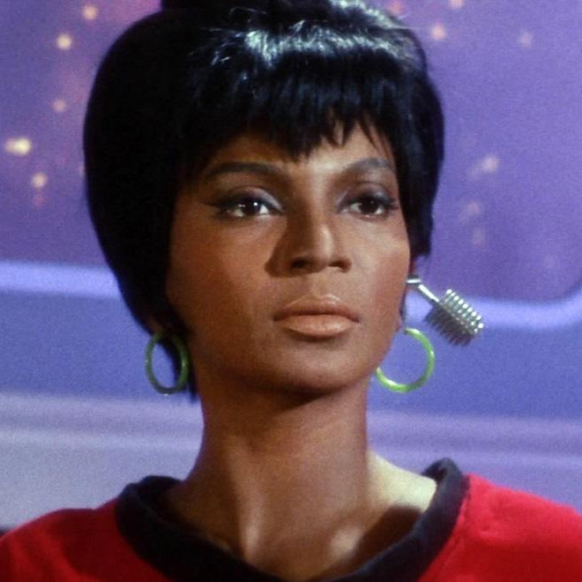
Thank You!
Ulugbek Isroilov
Flutter Uzbekistan: t.me/dartdevuz
Telegram: t.me/ulugbekisroilov

